Slide 1
Data Science in R with the Tidyverse

Slide 2
Book
R for Data Science (2e)
https://r4ds.hadley.nz/

Slide 3
What is R
R is an integrated suite of software facilities for data manipulation, calculation and graphical display.

Slide 4
Why R
Used by millions of data practitioners, researchers, academics, and the industry
A vibrant open-source community, producing a wealth of resources and advancements
Free
Open source

Slide 5
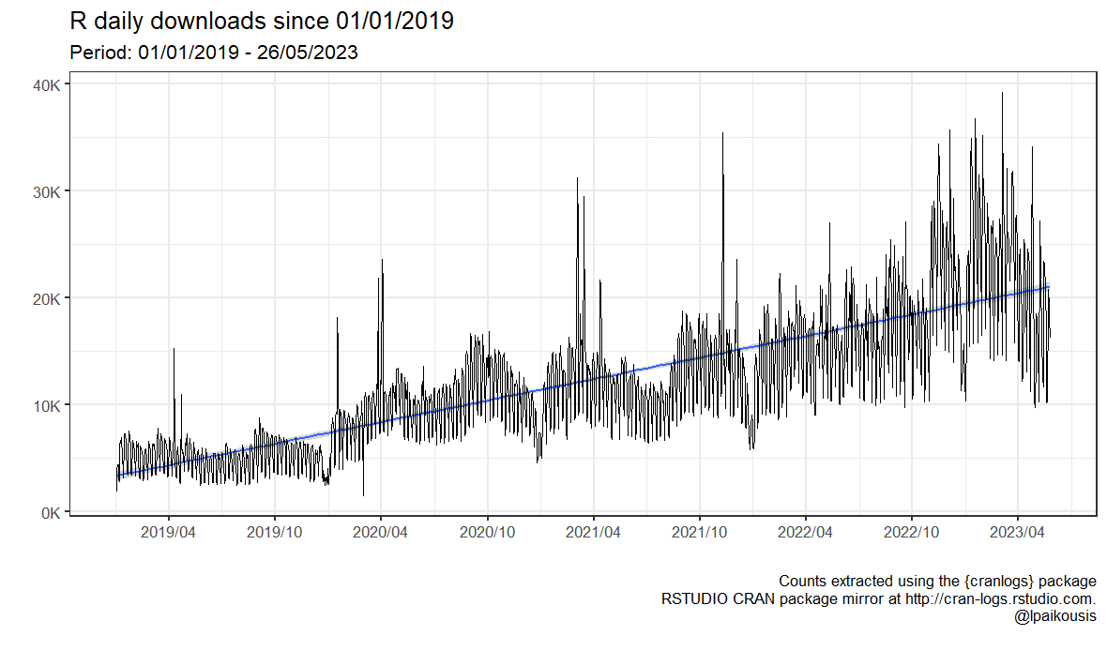
Why R

Slide 6
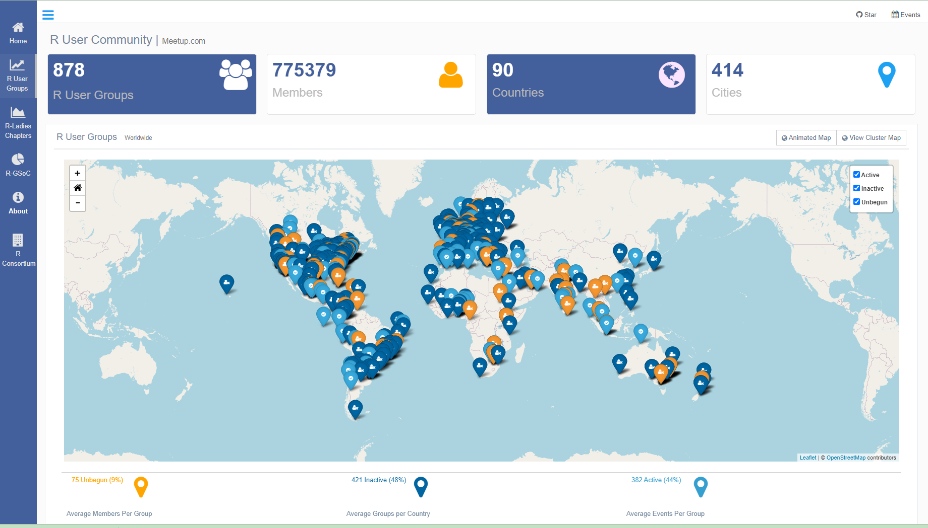
Why R [R User Groups, worlwide]
https://benubah.github.io/r-community-explorer/rugs.html

Slide 7
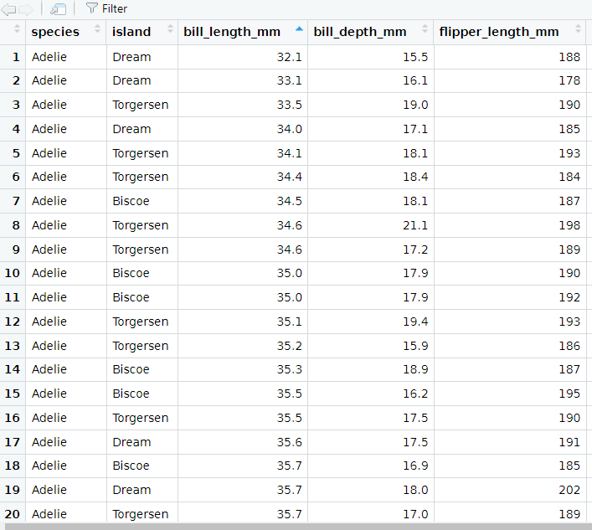
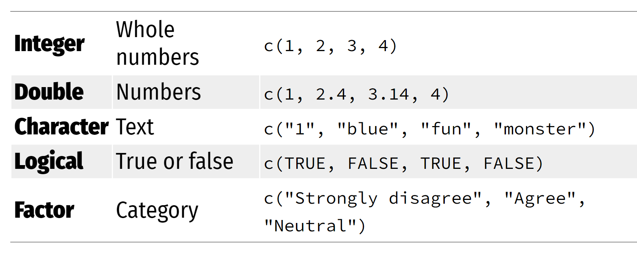
Objects in R (we will mostly use)
Data frame
Vectors

Slide 8
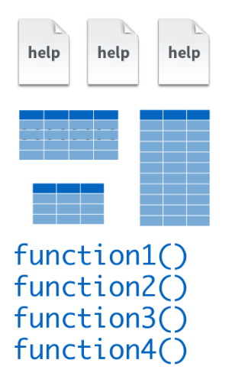
Base R

Slide 9
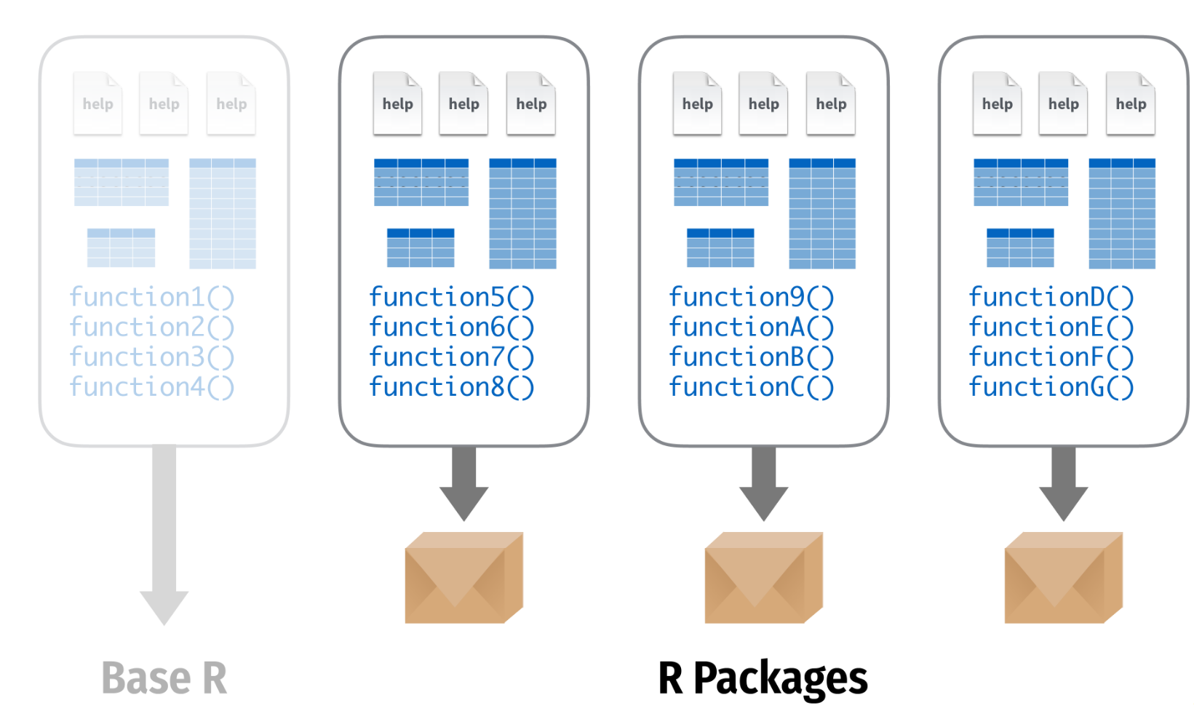
R packages
Credit: https://www.andrewheiss.com/
@andrewheiss

Slide 10
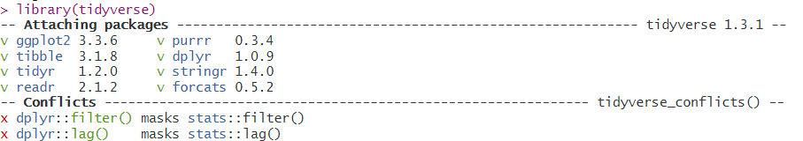
What is the Tidyverse
The tidyverse is an opinionated collection of R packages designed for data science. All packages share an underlying design philosophy, grammar, and data structures.
https://www.tidyverse.org/
Install the complete tidyverse with: `install.packages("tidyverse")`
Load the Tidyverse with: `library(tidyverse)`

Slide 11
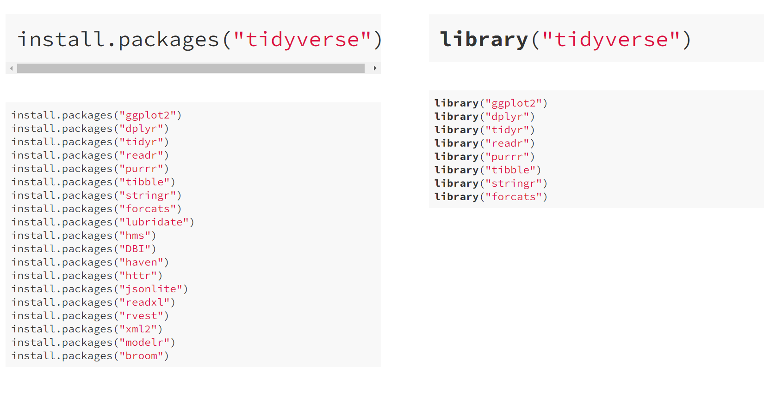
Tidyverse packages

Slide 12
Tidyverse https://www.tidyverse.org/

Slide 13
Cheat Sheets in RStudio

Slide 14
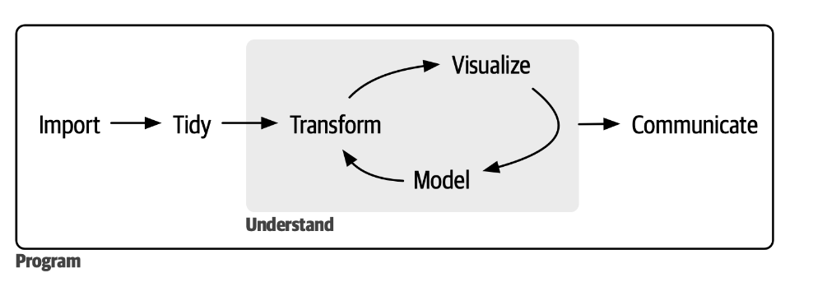
Data science workflow
https://r4ds.hadley.nz/

Slide 15
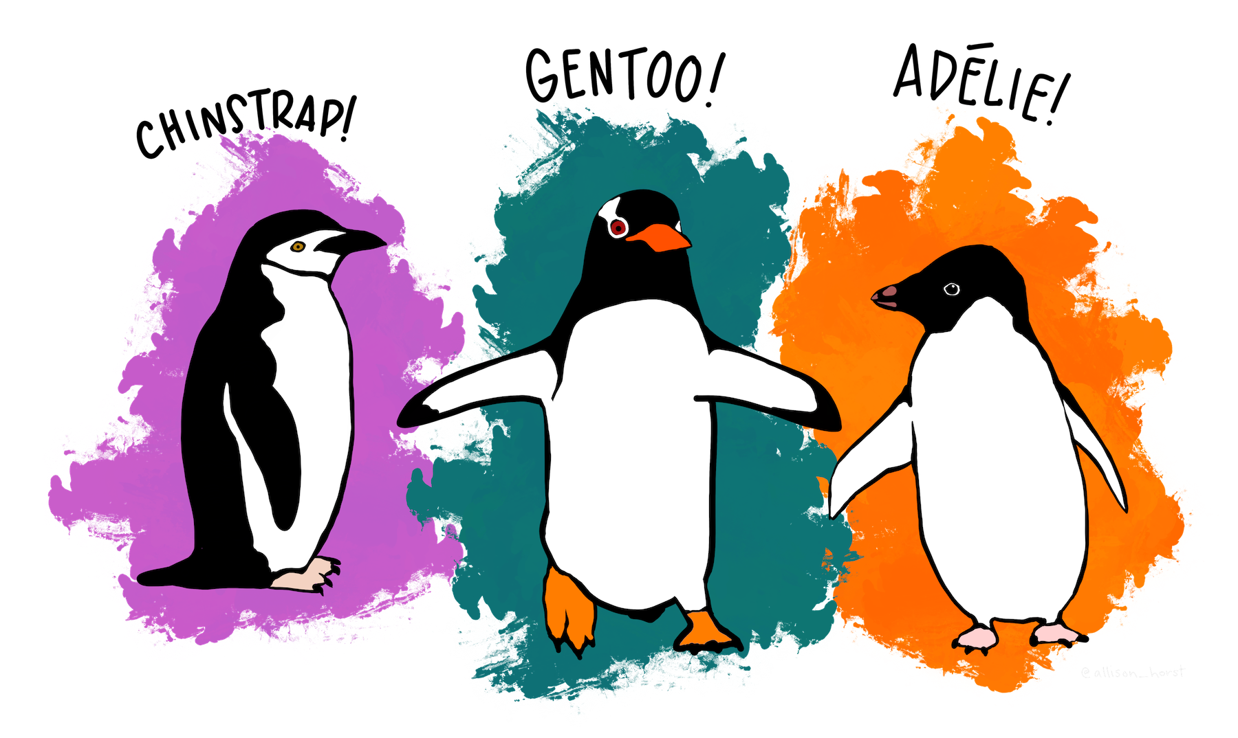
Palmerpenguins
https://allisonhorst.github.io/palmerpenguins/articles/intro.html

Slide 16
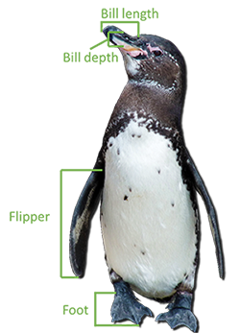
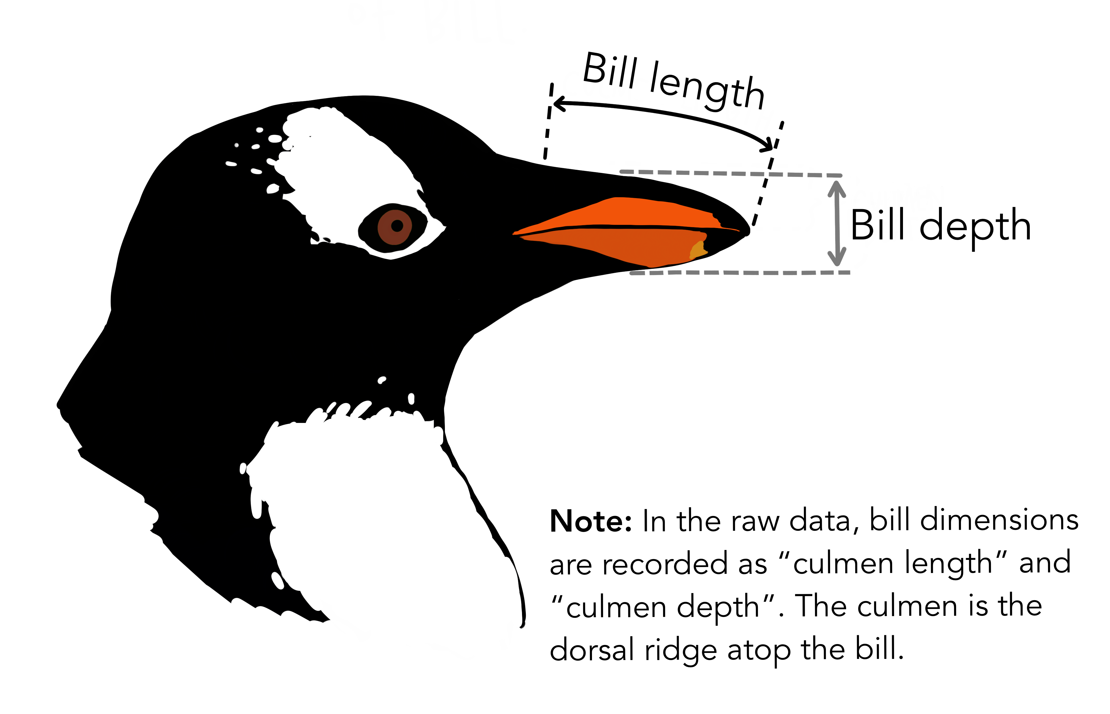
Palmerpenguins

Slide 17
Palmerpenguins
Do penguins with longer flippers weigh more or less than penguins with shorter flippers?
What does the relationship between flipper length and body mass look like? Is it positive? Negative? Linear? Nonlinear?
Does the relationship vary by the species of the penguin?
How about by the island where the penguin lives?
Let’s create visualizations that we can use to answer these questions.

Slide 18
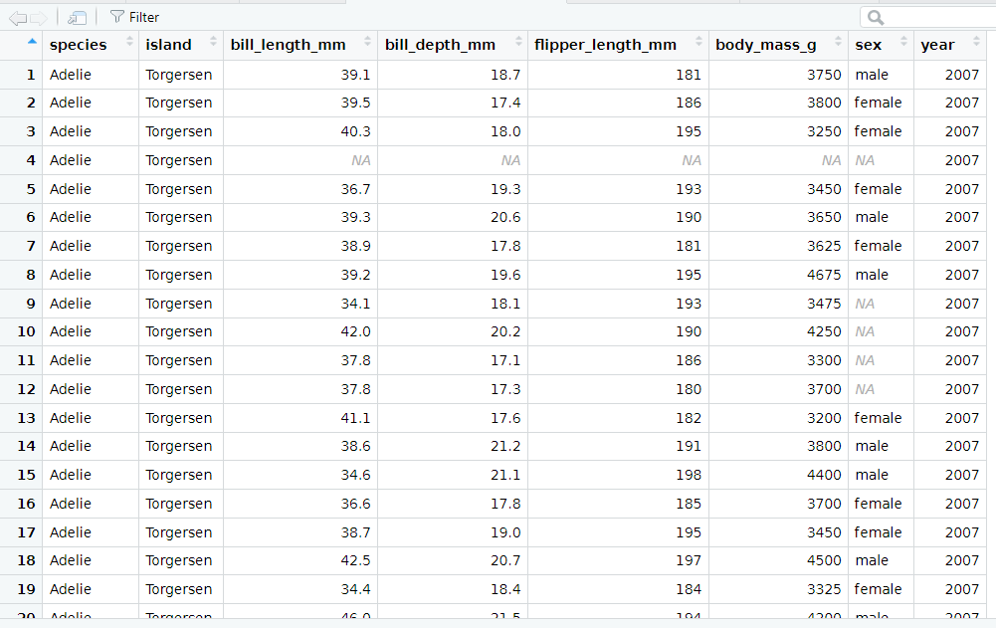
Terminology
A variable is a quantity, quality, or property that you can measure.
A value is the state of a variable when you measure it. The value of a variable may change from measurement to measurement.
An observation is a set of measurements. An observation will contain several values, each associated with a different variable.
Tabular data is a set of values, each associated with a variable and an observation.

Slide 19
What is this tidyverse
Tabular data is tidy if each value is placed in its own “cell”, each variable in its own column, and each observation in its own row.
The Tidyverse

Slide 20
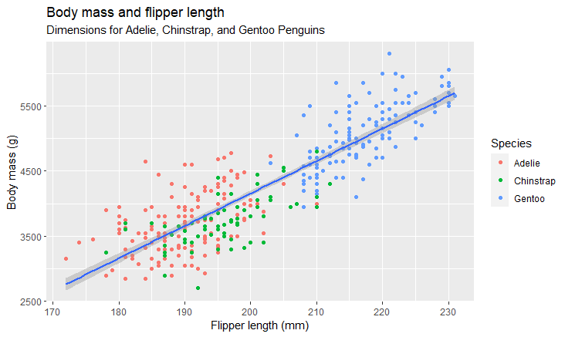
Our goal

Slide 21
Let’s do it
library( palmerpenguins )
We follow the path here: https://r4ds.hadley.nz/data-visualize.html

Slide 22

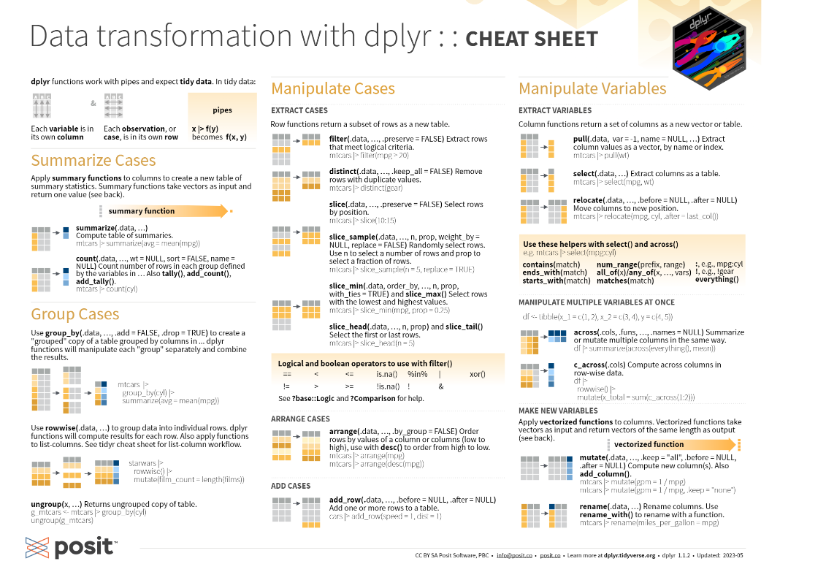
{dplyr} – A grammar of data manipulation
https://dplyr.tidyverse.org/

Slide 23
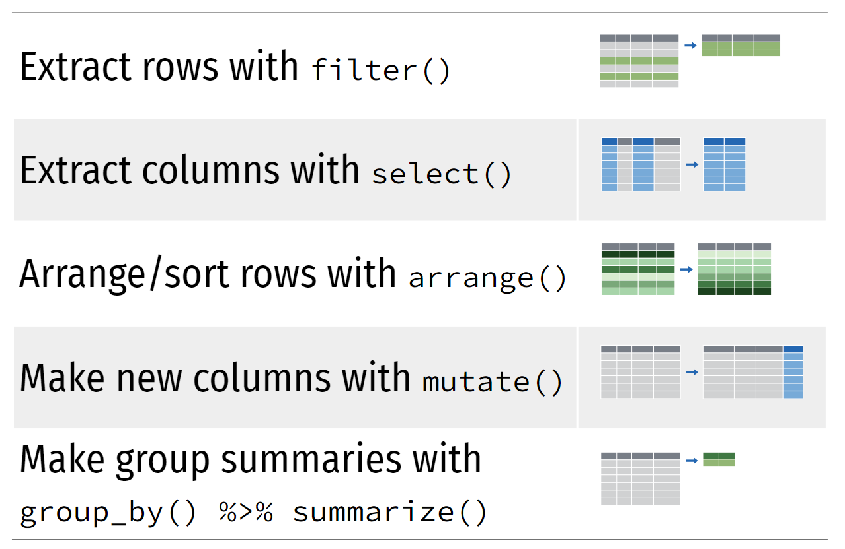
{Dplyr} basic verbs (the ones we will mostly use)
Credit: https://www.andrewheiss.com/
@andrewheiss

Slide 24
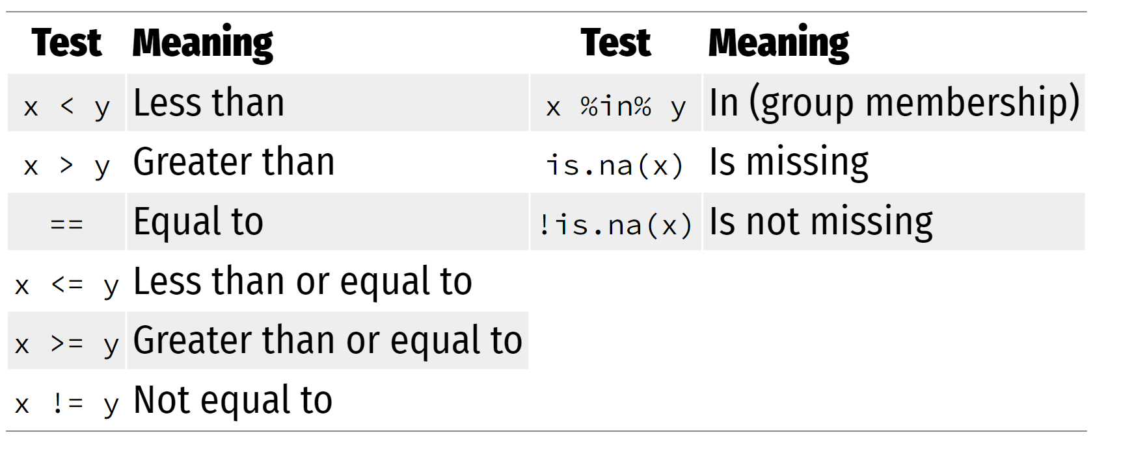
Boolean operators for filtering
Credit: https://www.andrewheiss.com/
@andrewheiss

Slide 25
{ggplot2} – A Grammar of Graphics
ggplot(data = DATA) + GEOM_FUNCTION(
mapping = aes(AESTHETIC MAPPINGS)
)

Slide 26
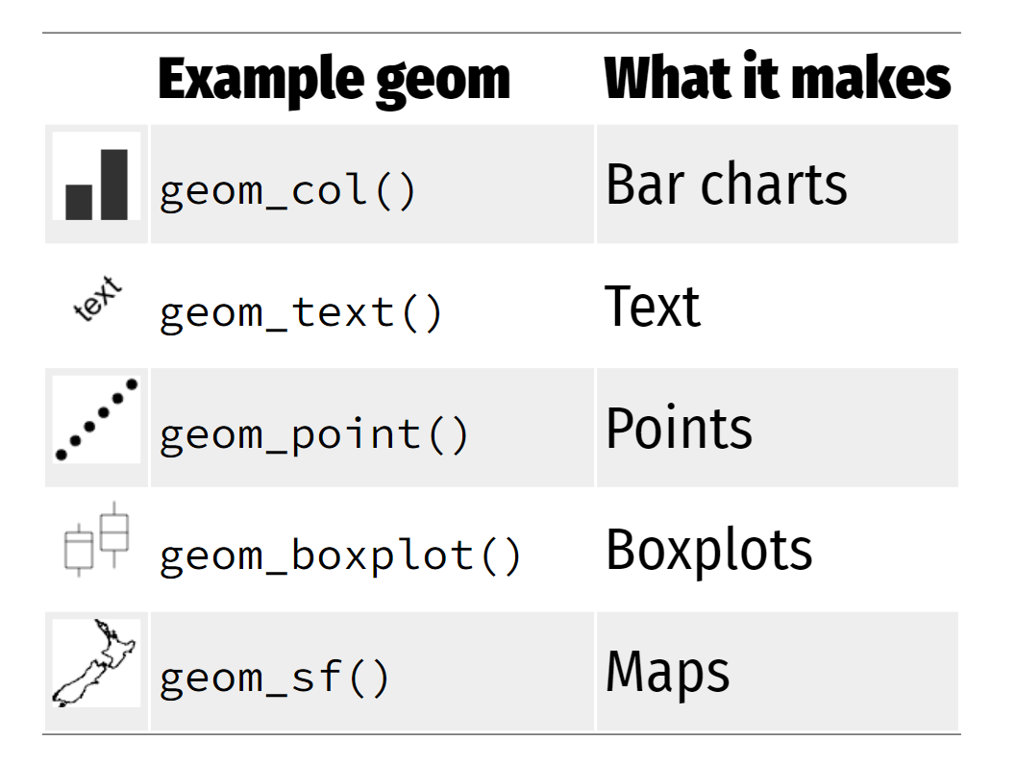
{ggplot2} geoms [geometric functions]
Credit: https://www.andrewheiss.com/
@andrewheiss

Slide 27
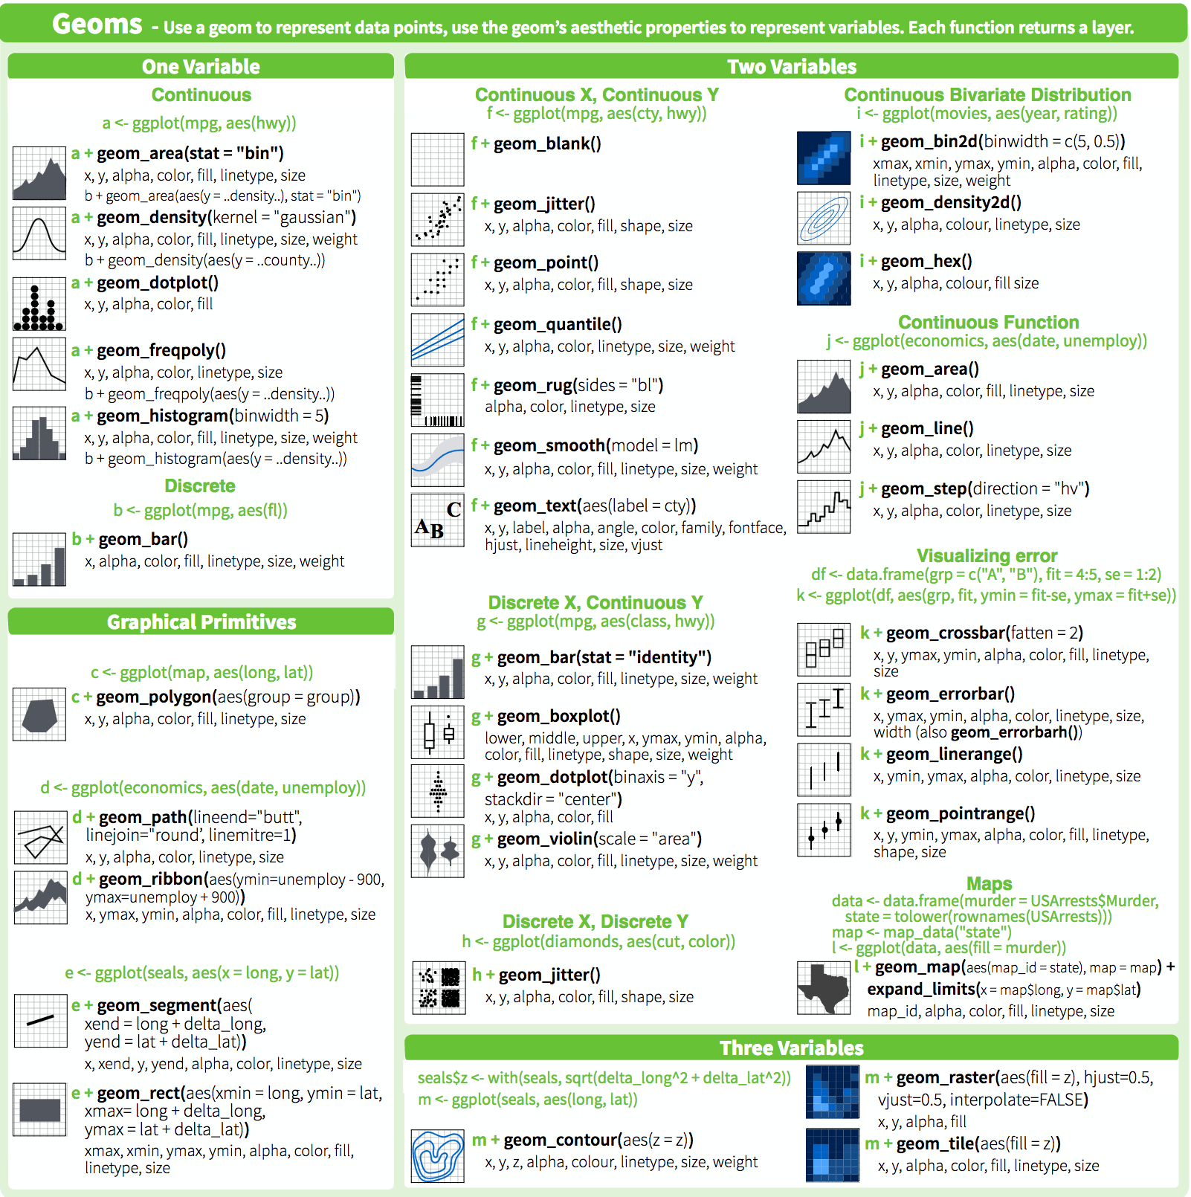
{ggplot2} geoms

Slide 28
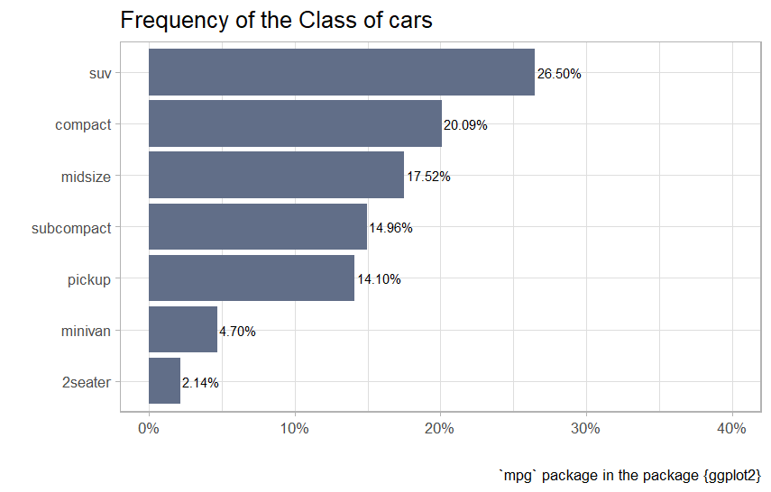
Your turn
Recreate this plot
You might need some of the {forcats} functions
forcats::fct_infreq()
forcats::fct::rev()
Find a colour you like at
https://www.color-hex.com/

Slide 29
Your turn
mpg |>
mutate(class = fct_infreq(class)) |>
count(class) |>
mutate(pct = n / sum(n)) |>
ggplot(aes(x = fct_rev(class), y = pct)) +
geom_col(fill = "#616e88") +
geom_text(aes(label = scales::percent(pct)), size = 4, hjust = -0.05)+
coord_flip()+ scale_y_continuous(labels = scales::percent, limits = c(0,0.4))+
theme_light(base_size = 16) +
labs(
title = "Frequency of the Class of cars ",
x = "",
y = "",
caption = "`mpg` package in the package {ggplot2}"
)

Slide 30




{readxl} – read .xlsx files into R https://readxl.tidyverse.org/
{readr} – read & save delimited files into R https://readr.tidyverse.org/
{haven} – read SPSS and SAS files into R https://haven.tidyverse.org/
{writexl} – Write tables in .xlsx format https://docs.ropensci.org/writexl/

Slide 31
Resources
R Markdown
R Markdown the definitive guide https://bookdown.org/yihui/rmarkdown/
R Markdown Cookbook https://bookdown.org/yihui/rmarkdown-cookbook/
https://www.tidyverse.org/packages/
https://r4ds.hadley.nz/

